Slide 1
Current Status of YouTube Simulation
January 9th, 2024
Sasha Rabeno

Slide 2
What does it do now?
Generates flexible number of agents and videos, in accordance with archetype parameters/distribution.
Runs simulation of video-watching for four different recommendation algorithms:
No system
Filtered list
Filtered list with 10% chance of watching an entirely random video
Scoring system
Graphs the following for each system, w/ side-by-side regression curves to compare between systems:
Avg. extremeness of videos watched per agent
Minutes watched per agent (by both extremeness and agent #, which in this case correlate)
Number of videos watched per agent

Slide 3
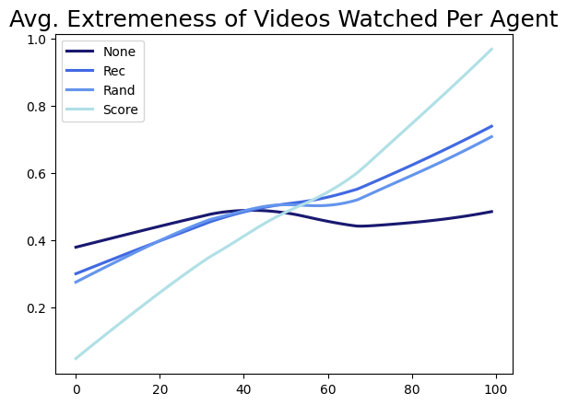
Avg. Extremeness of Videos Watched Per Agent

Slide 4
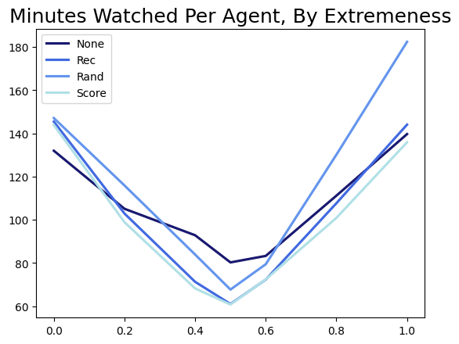
Minutes Watched Per Agent, By Extremeness
Make y axis extremeness of videos watched
Make x axis the longest video threshold, or yt time threshold, or pop threshold
- > each of the other parameters, one graph at a time
If you’re switching to generate random, non-archetype agents, sort the agents by extremeness on x-axis and see what their watched extremeness is on y-axis. Etc.

Slide 5
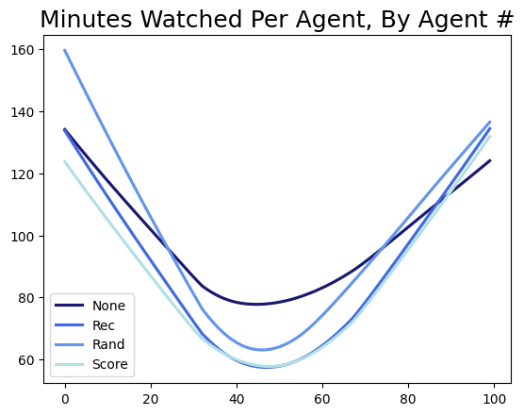
Minutes Watched Per Agent, By Agent #

Slide 6
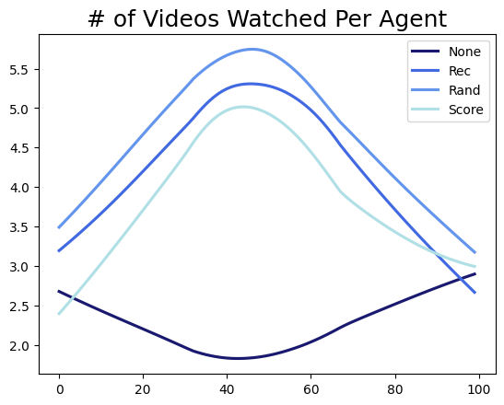
# of Videos Watched Per Agent

Slide 7
What does the simulation currently show?
Average extremeness of videos watched goes up for each of the rec systems. This effect is much more pronounced in the scoring system.
Agents on the extremes watch more minutes of content with the rec systems than without. However, agents in the middle watch less minutes of content with the rec systems.
For every rec system, users watch a higher quantity of videos, with those in the middle having the highest increase in number of videos watched.
Despite the middle agents watching more videos, they’re watching for less time. This makes sense---the middle agents prefer shorter videos, so they’re likely watching a bunch of really short videos.

Slide 8
What are potential next steps/research questions to answer?
Look at how each system affects users in the middle and extremes separately, rather than just the overall averages
e.g. Find the averages for each graph for, say, just the middle three categories of agent, and see how what they watch changes for each system.
Mess around with the scoring system. Change around the parameters and the weights and such to see what can happen.
E.g. how do the results of the scoring system change depending on how the parameters change?
Try making the agents a lot more random
e.g. Generate however many agents, but instead of following a distribution for their viewing preferences and habits, all of their attributes are completely random. Disregard the archetypes entirely.
What would a normal person want to know from this work? What questions are we missing here?

Slide 9
Look at how each system affects users in the middle and extremes separately, rather than just the overall averages. Goal: see how more run-of-the-mill, not extreme users are affected by the different rec. systems.
Steps to do so:
Run simulation with just the agents in the middle three archetypes, aka the middle 56% of agents. Or, generate only agents in these three archetypes (might be easier).
"passive_liberal": 0.15,
"politically_disengaged": 0.26,
"moderate": 0.15,
Generate graphs, with averages like usual, for just these agents, instead of everybody.
Compare side-by-side how the numbers change for these middle agents.
If desired, repeat for just the extreme agents.

Slide 10
Look at how each system affects users in the middle and extremes separately, rather than just the overall averages.
Each graph is an x-y scatter plot. Let’s look at just the first part of the first graph, Avg. Extremeness of Videos Watched Per Agent.
x = numpy.arange(0, NUM_AGENTS)
y = Reverse(extr_of_each_agent_video_all)
How does this have to change? For 100 agents (to make my life easier), the range will be from 19 to 74 (so, the middle 56 agents). Thus,
x = numpy.arange(19, 74).
For y, extr_of_each_agent_video_all needs to lose values 0-18, and 75-99. We can make a copy of this array that’s just the middle 56 values. So, copy = extr_of_each_agent_video_all [19:74]. Therefore:
y = Reverse(extr_of_each_agent_video_all[19:74]), or Reverse(copy).

Slide 11
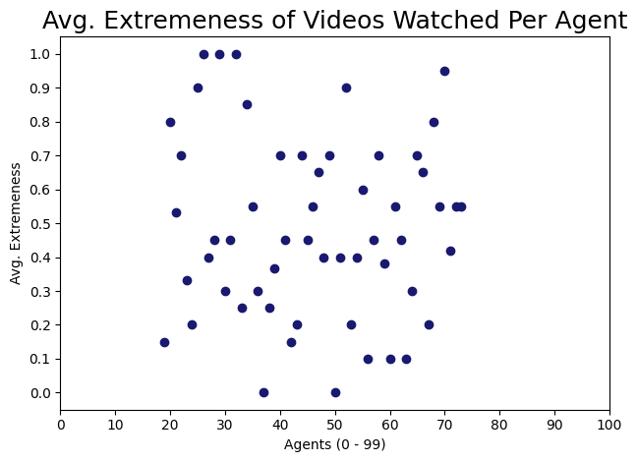
The previous slide’s work gives the following graph.
Let’s repeat this for the other systems in this particular graph.

Slide 12
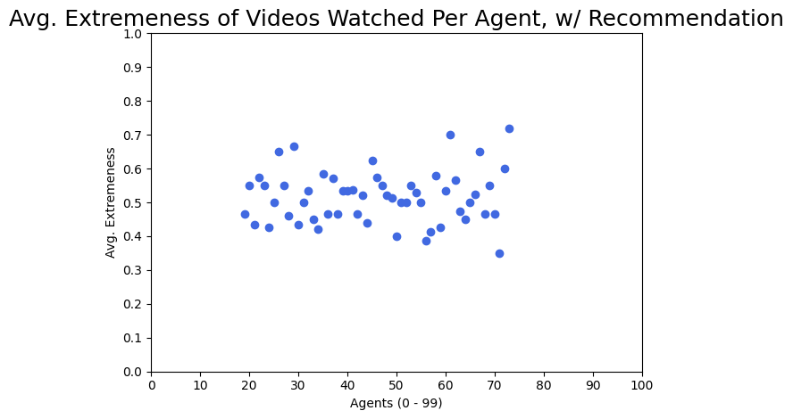

Slide 13
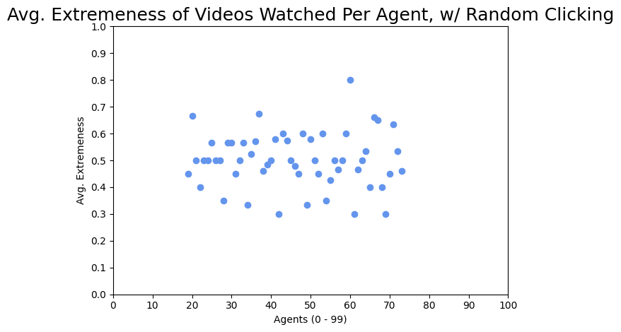

Slide 14
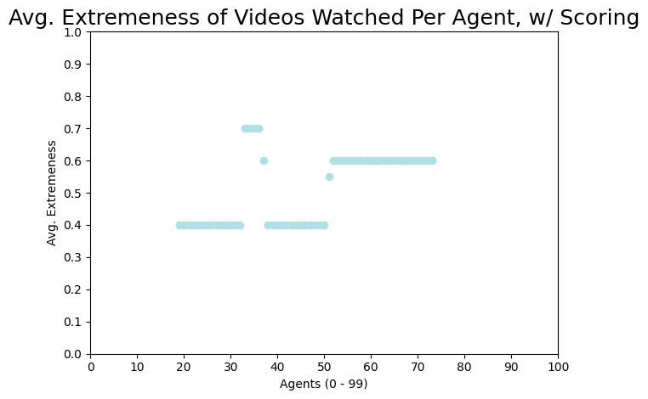

Slide 15
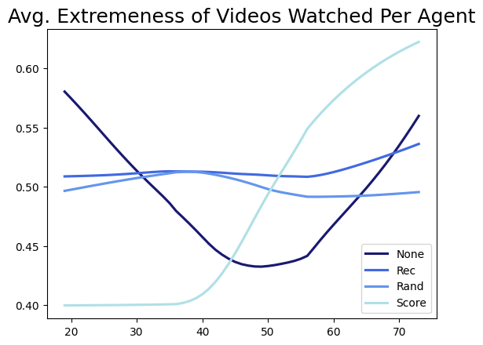
The final regression graph looks like this:
This isn’t super helpful without any numbers. But based on my rudimentary look at this, here’s what I can tell:
- The placebo pattern (no rec system) has extremeness of videos watched ranging from 0.43 to 0.58 (with those on the ends, aka not in the dead center, watching slightly more extreme videos.
- For the filtered list systems (rec and rand), the extremeness goes up for the lower users and down for the edge ones. Thus, the filtered list systems sort of “average out” the extremeness for this subset of users.
- For the scoring system, users’ preferences get more extreme! The slightly-left-wing users get recommended more left wing content, and same for the slightly-right-wing users. The middle sort of evens out, but has sharp jumps between users.

Slide 16
tl;dr from the last slide
Again, from what I am observing with my eyes (and not numbers), the filtered list systems (rec/rand) make users watch more middle-of-the-line videos regardless of their own preferences, while the scoring system makes users watch more extreme content. Neat stuff!
Remember that “users” here is just the middle 56% of all the overall users, AKA those who fall into one of the three middle archetypes. Thus, this graph shows that these more run of the mill users are watching incredibly average content with the filtered lists, but are pushed to more extreme content with the scoring system.

Slide 17
Why is this important?
The scoring system was my attempt to get as close to what YouTube does as possible (since I am 99% sure they use a weighted scoring system as well---I have a paper somewhere that confirms this). Thus, the fact that the scoring system (aka more accurate YouTube simulation) makes users watch more extreme content sort of answers our chief research question: do recommendation algorithms push users to watch more extreme content than they normally would? For this case, we can say yes!
The graph on the right is effectively a really zoomed in version of the shaded region of the overall graph on the left.

Slide 18
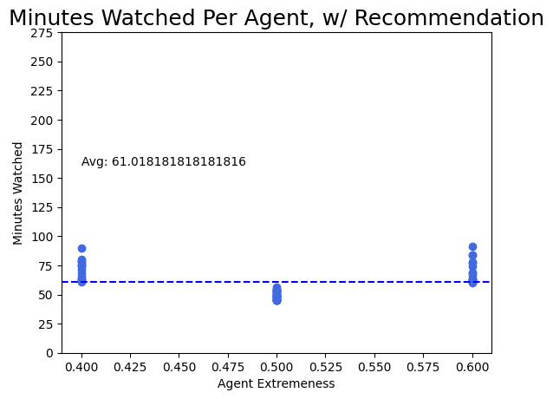
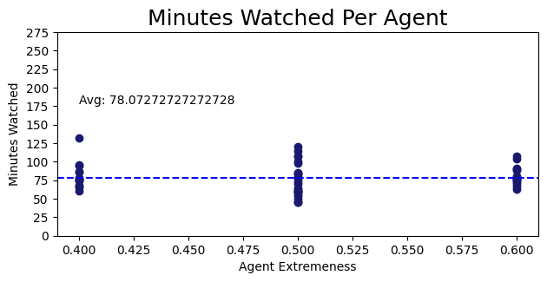
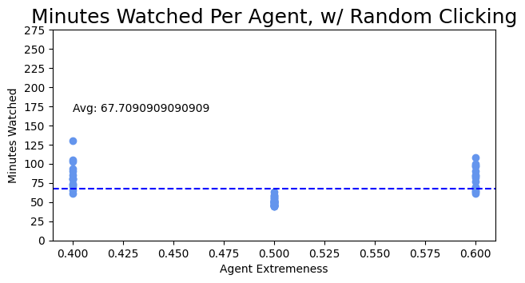
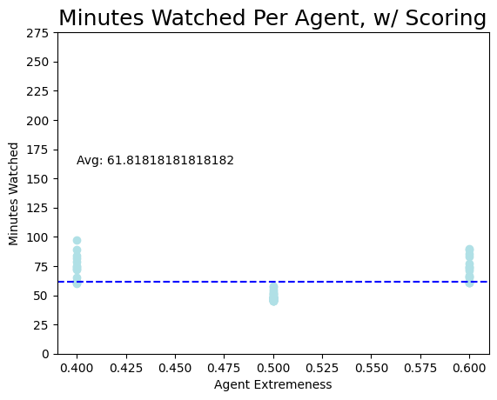
Middle Agents Minutes Watched

Slide 19
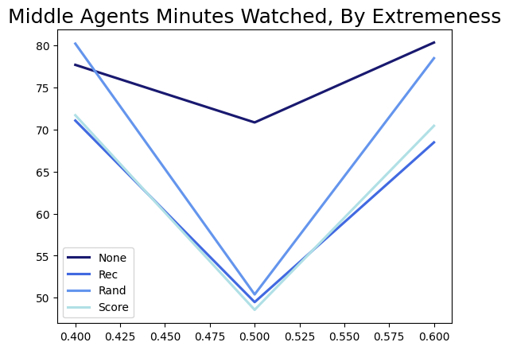
Minutes Watched Cont’d.
No system: 78.072 minutes
Filtered list system: 61.018 minutes
Filtered list w/ random clicking: 67.709 minutes
Scoring system: 61.818 minutes
This is the same as what we saw overall; the rec systems are making middle users watch for less time.

Slide 20
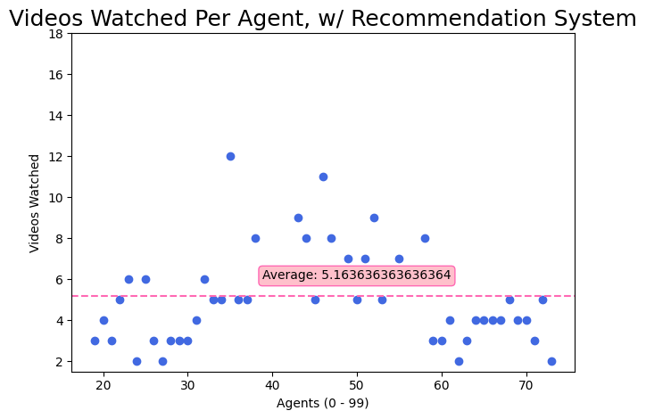
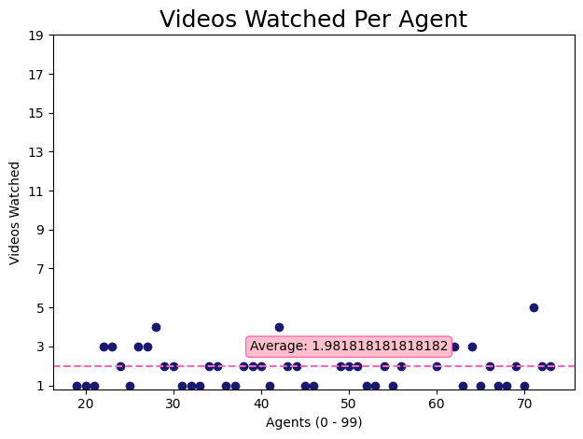
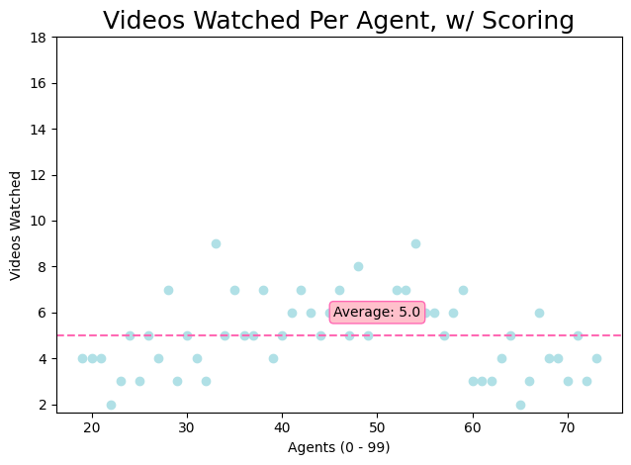
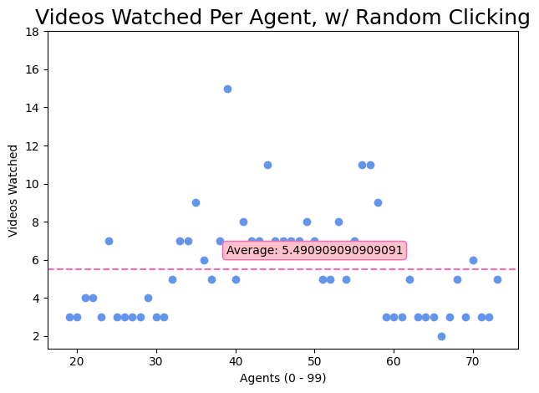
Middle Agents # of Videos Watched

Slide 21
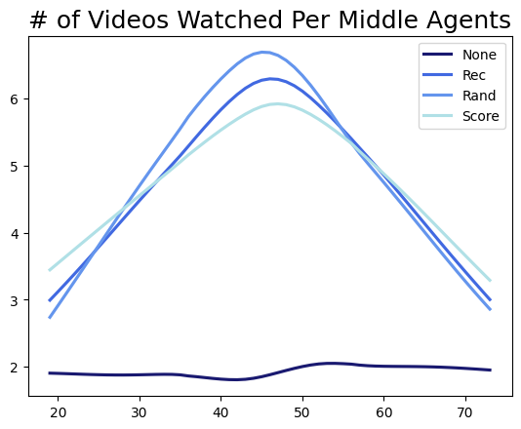
Videos Watched Cont’d.
No system: 1.98 videos
Filtered list system: 5.16 videos
Filtered list w/ random clicking: 5.49 videos
Scoring system: 5.00 videos
This also mirrors what we saw before; all the rec systems make users watch a higher quantity of videos, despite the videos being shorter.

Slide 22
Meeting 1/24/24

Slide 23
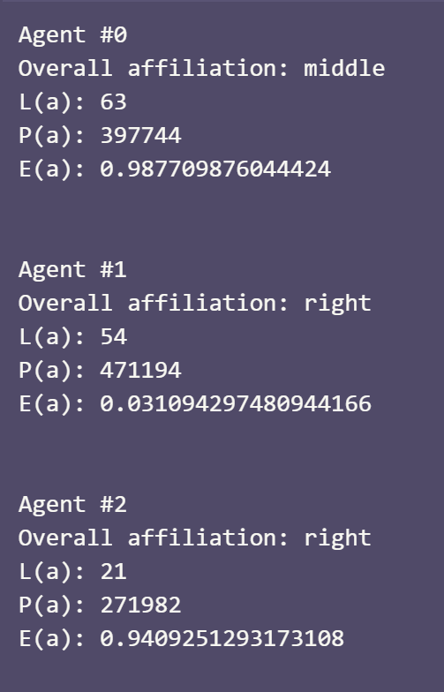
What did I do?
Generate all agents to have completely random attributes
Run the same graphs as before (plus one more, just sorted by agent extremeness) with random agents for the normal and scoring systems.
Unlike before, agent # doesn’t correlate in any way to the agent’s extremeness, so having the x-axis be individual agent # doesn’t tell us anything about trends.

Slide 24
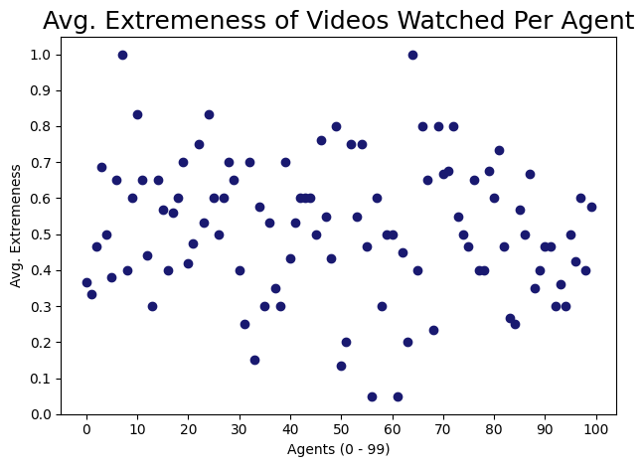
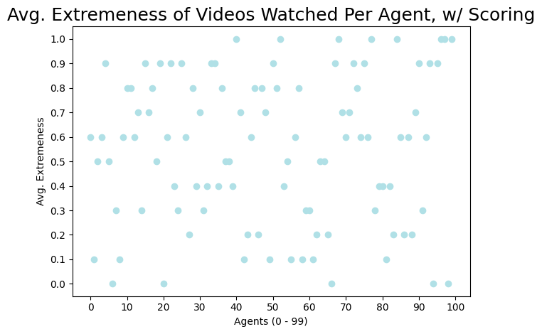

Slide 25
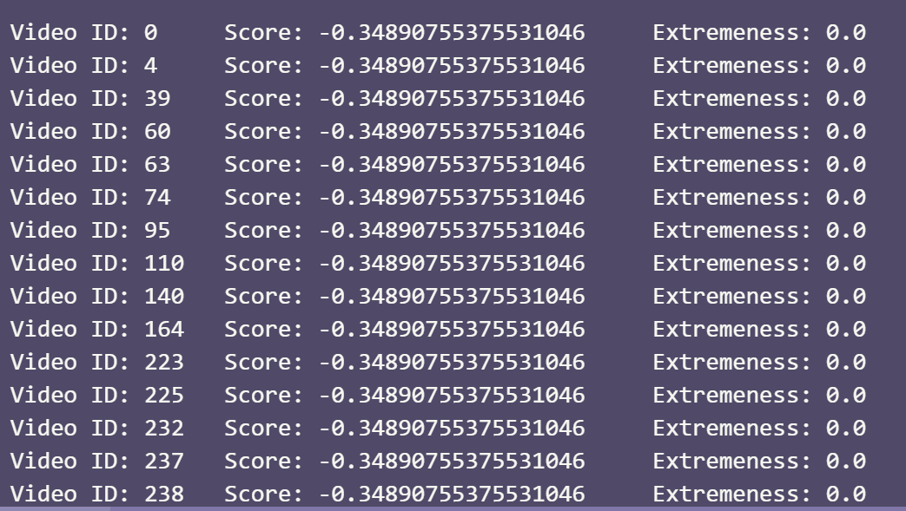
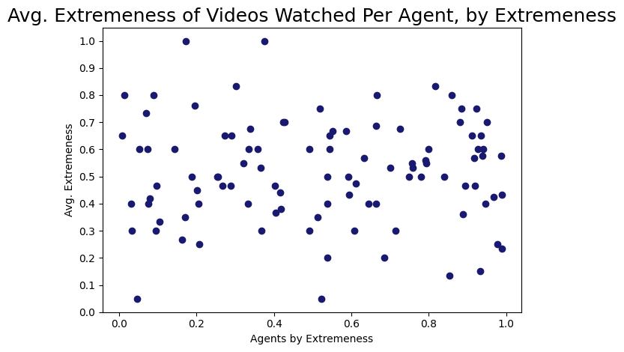
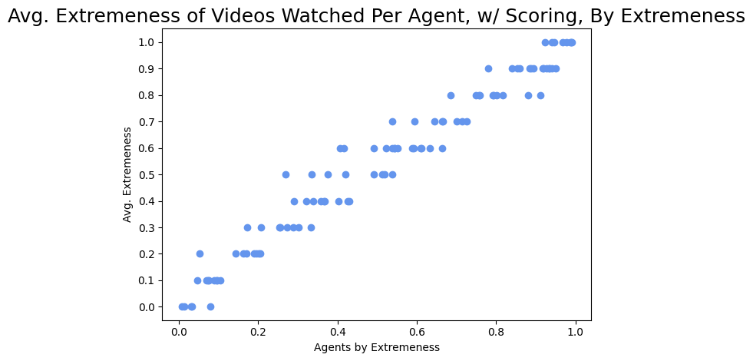
Why the horizontal lines? Why no trend on the left?
I think it’s because in the scoring, the first large amount of videos all have the same extremeness, and video extremeness-es are NOT random floats. Rather, they’re all picked from [0.0, 0.1, 0.2, 0.3, 0.4, 0.5, 0.6, 0.7, 0.8, 0.9, 1.0]
Maybe relax the strength of extremeness preference in the scoring system so people watch a greater variety of extremenesses
Look at that trend line!

Slide 26
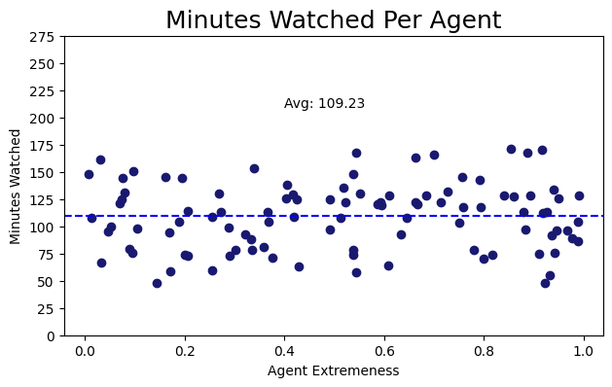
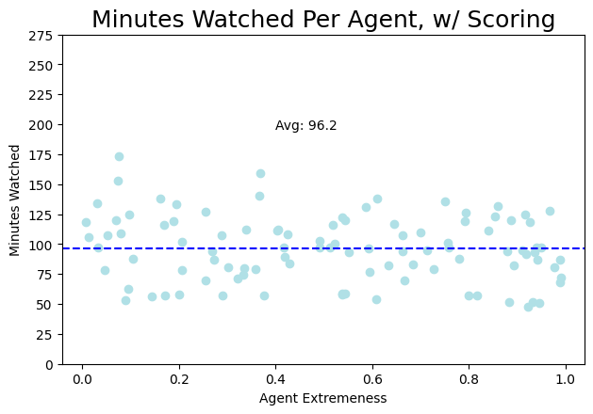
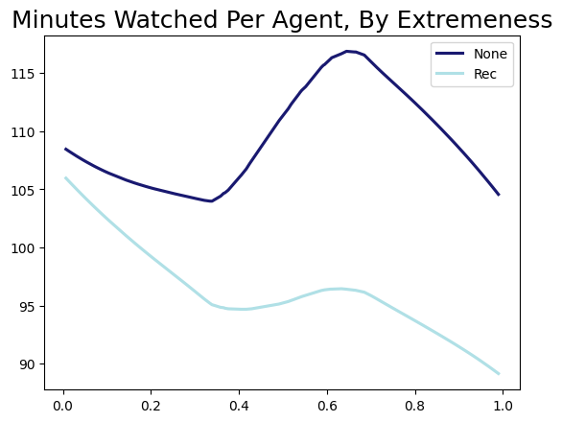
By Extremeness
Why does the average go down? Why is there no stratification on the extremes? i.e. shouldn’t the people on the extremes be watching longer videos, as is their preference? Or does this preference no longer exist, since it was tied to archetypes (where more extreme watching archetype == longer videos will be watched)? The stratification shows up I believe in the graphs w/ archetypes.

Slide 27
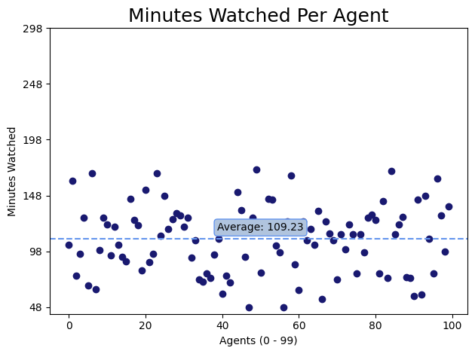
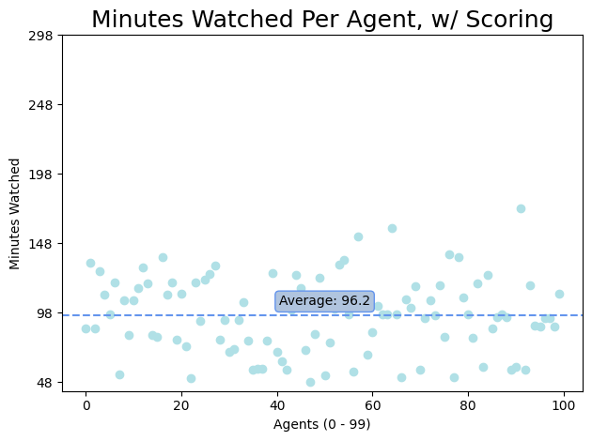
(same averages/values as the previous slide, just sorted by agent and not extremeness. which is why it looks more random.)

Slide 28
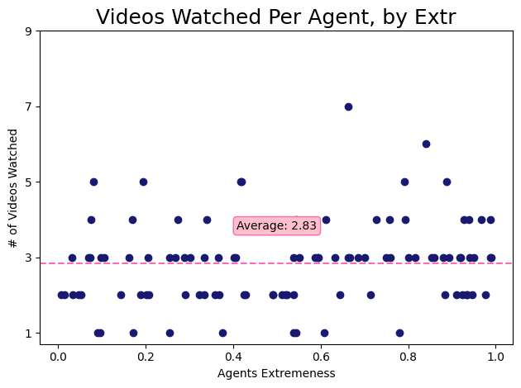
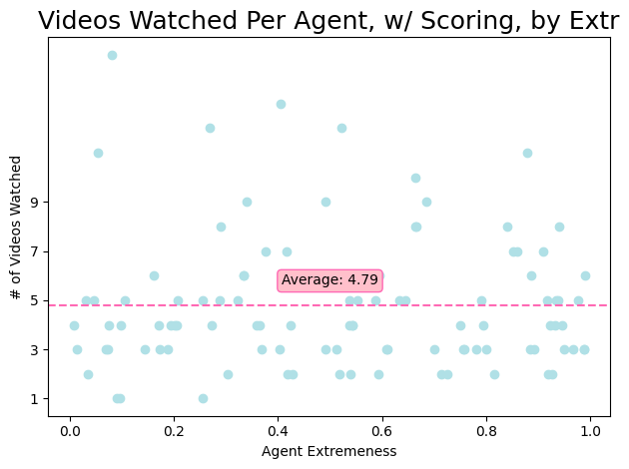

Slide 29
Comparing across archetypes and scoring/non-scoring
w/ Archetypes
w/out Archetypes
Variable (Averages)
Normal
Scoring
Normal
Scoring
Minutes watched (per agent)
92.12
85.13
109.23
96.2
Videos watched (per agent)
2.37
4.23
2.83
4.79
Extremeness of videos watched (overall)
0.475
0.503
0.518
0.5578
Without archetypes, all the values go up---the amount of minutes watched, # of videos watched, and average extremeness of all the videos watched.
Without archetypes, the average extremeness goes up slightly, the number of videos watched nearly doubles, and the number of minutes watched goes down. The same pattern happens with archetypes.
TODO: which is happening---is the simulation perfectly modeling irl, especially with the decrease in minutes watched? Or are there exclusions and assumptions being made that are leading to this? Figure it out.
The model said xyz---should I believe it? Is that part of the model I should change? Or am I learning something new?
I tried looking around a bit for the decrease in minutes watched, and maybe it’s modeling something like YouTube Shorts? Where they’re watching more of them, but they’re shorter videos (therefore it’s possible to watch more of them in a smaller amount of time)? Am I reinventing the YouTube Shorts wheel here?
Is there something in the scoring formula that makes people want shorter videos?
Be more precise---try to explain what the algorithm does in more precise terms. This outcome happens because the algorithm does xyz mathematical thing that leads to abc. As opposed to arguments like “people like to watch shorter videos,” which may be true, but has to be represented in the code if you’re saying that.

Slide 30
Meeting 2/5/24

Slide 31
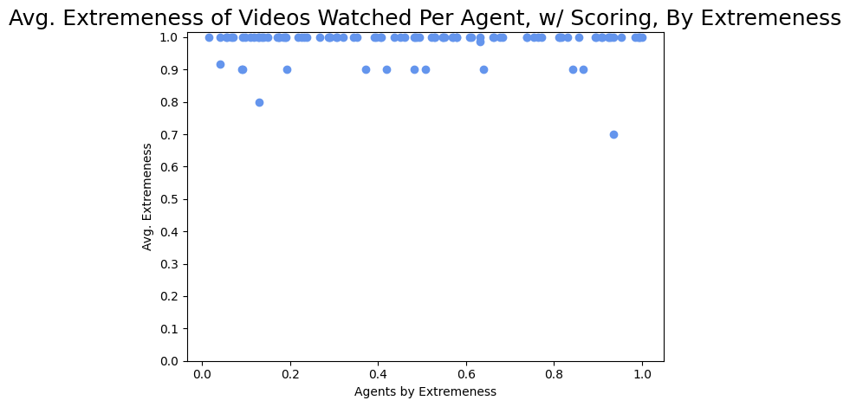
Messing Around w/ the Scoring Function (goal: try and loosen the restrictions to avoid the step-function-looking result.)
Original
alpha = 0.2 video length
beta = 0.15 video popularity
gamma = 0.5 video alignment delta = 0.15 video extremeness
Here
alpha = 0.3 video length
beta = 0.3 video popularity
gamma = 0.1 video alignment delta = 0.3 video extremeness

Slide 32
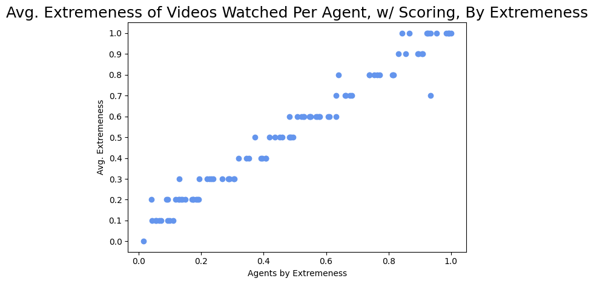
Messing Around w/ the Scoring Function (goal: try and loosen the restrictions to avoid the step-function-looking result.)
Original
alpha = 0.2 video length
beta = 0.15 video popularity
gamma = 0.5 video alignment delta = 0.15 video extremeness
Here
alpha = 0.2 video length
beta = 0.3 video popularity
gamma = 0.2 video alignment delta = 0.2 video extremeness

Slide 33
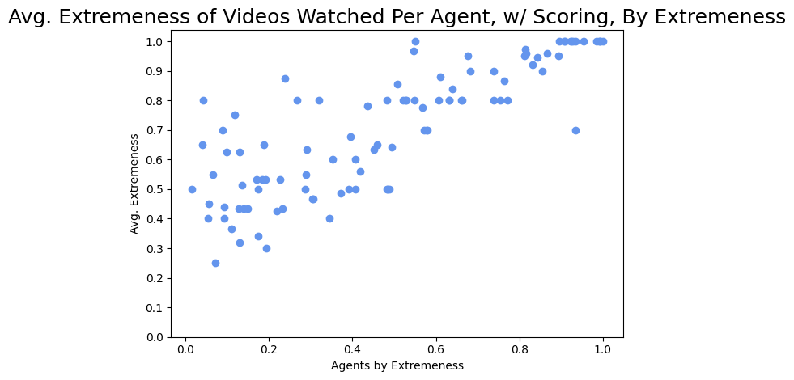
Messing Around w/ the Scoring Function (goal: try and loosen the restrictions to avoid the step-function-looking result.)
Original
alpha = 0.2 video length
beta = 0.15 video popularity
gamma = 0.5 video alignment delta = 0.15 video extremeness
Here
alpha = 0.4 video length
beta = 0.4 video popularity
gamma = 0.1 video alignment delta = 0.1 video extremeness
Todo: Make sure delta rewards being at the extremes, not close to 1

Slide 34
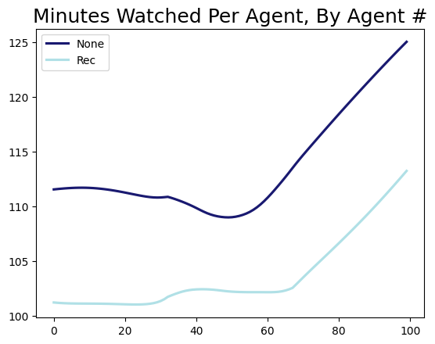
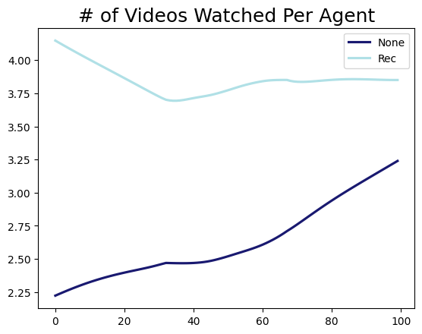
Continuing on This Particular Scenario (goal: try and loosen the restrictions to avoid the step-function-looking result.)
The same pattern of watching less minutes, but a higher number of videos, continues here, even with a much larger emphasis on video length (and popularity).
Todo: in the top graph, the light blue line should theoretically be about the same because users are watching until their time limit is exhausted
Here
alpha = 0.4 video length
beta = 0.4 video popularity
gamma = 0.1 video alignment delta = 0.1 video extremeness

Slide 35
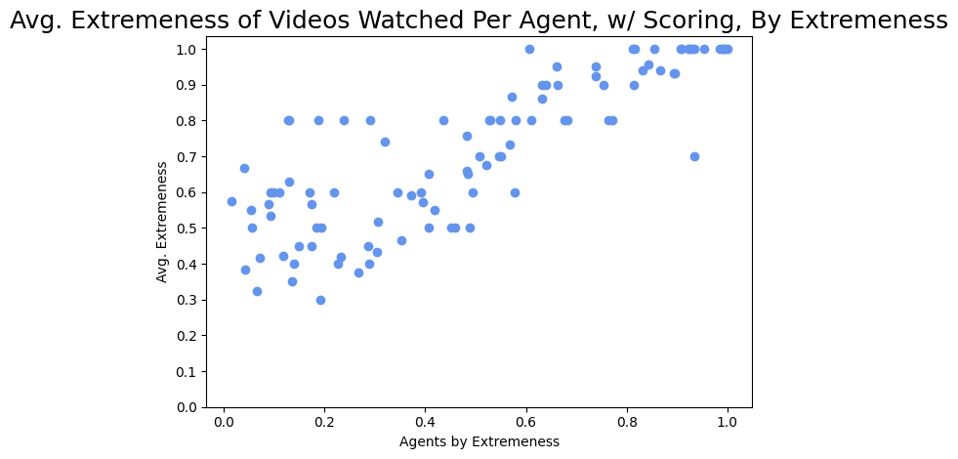
Expanding on the Last Slide What if we really bump the influence of video length?
The baseline extremeness shifts---in this scenario, it means the average video watched is more right-wing.
Why? I’m unsure.
Here
alpha = 0.7 video length
beta = 0.1 video popularity
gamma = 0.1 video alignment delta = 0.1 video extremeness

Slide 36
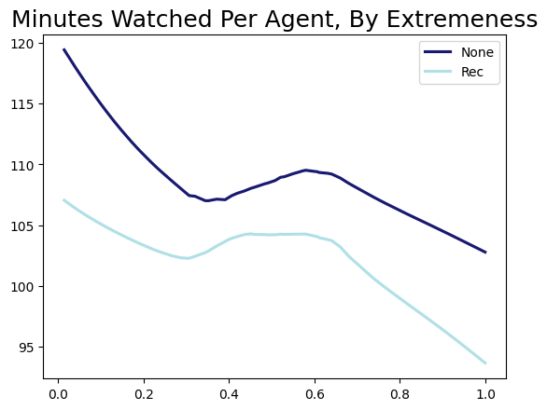
Expanding on the Last Slide What if we really bump the influence of video length?
However, the amount of minutes watched gets closer (no scoring = avg of 108.98, scoring = avg of 103.12).
Here
alpha = 0.7 video length
beta = 0.1 video popularity
gamma = 0.1 video alignment delta = 0.1 video extremeness

Slide 37
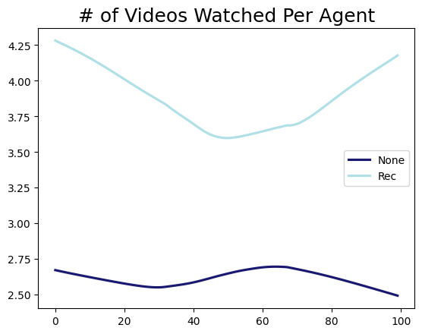
Expanding on the Last Slide What if we really bump the influence of video length?
The # of videos watched still stays nearly the same, but get a LITTLE closer (4.23 videos watched with scoring vs. 2.8 watched without).
Here
alpha = 0.7 video length
beta = 0.1 video popularity
gamma = 0.1 video alignment delta = 0.1 video extremeness

Slide 38
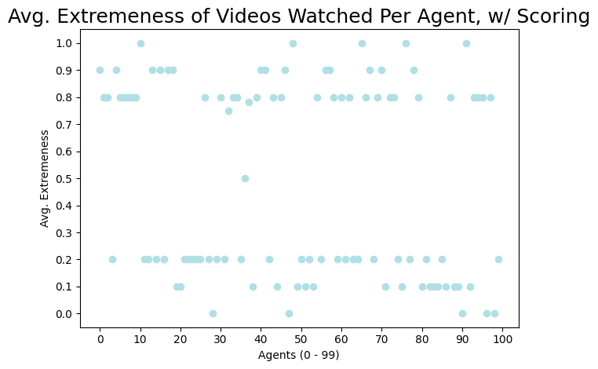
Oh, Dear
Make sure delta rewards being at the extremes, not close to 1
if((ev <= 0.2) or (ev >= 0.8)):
e_return = 1
else:
e_return = 0
Make delta the value that’s getting manipulated, not e_return
Make 0.2 and 0.8 parameters/vars that you can change, not hardcoded

Slide 39
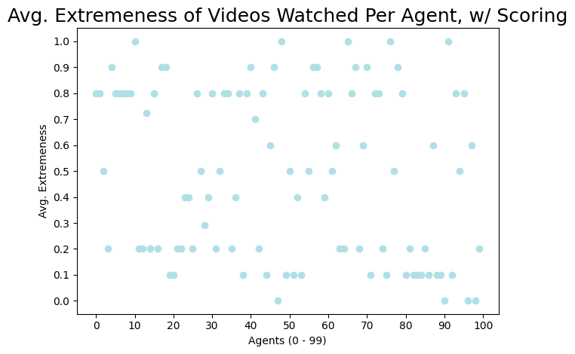
Oh, Dear
Make sure delta rewards being at the extremes, not close to 1
if((ev <= 0.2) or (ev >= 0.8)):
e_return = 0.5
else:
e_return = 0

Slide 40
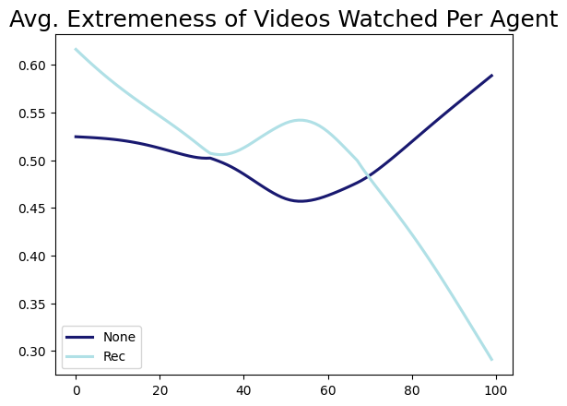
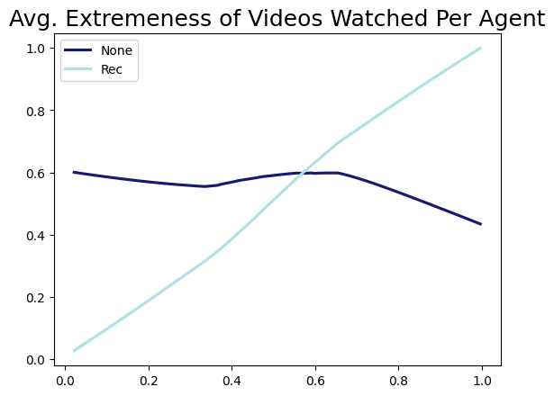
Left = no change, Right = rewarding extremes todo: in the right graph, dark blue line, delta = 0. see what happens when you change delta. Do the same for all parameters send by Friday a list of three more questions you can answer with a numerical experiment 1. Is it possible to reduce the emphasis on extremeness but keep total minutes watched approximately the same? Reduce emphasis on extremeness = change delta. Can these other weights be changed in order to reduce delta, ut keep people watching lots of videos?

Slide 41
Meeting 2/19/24

Slide 42
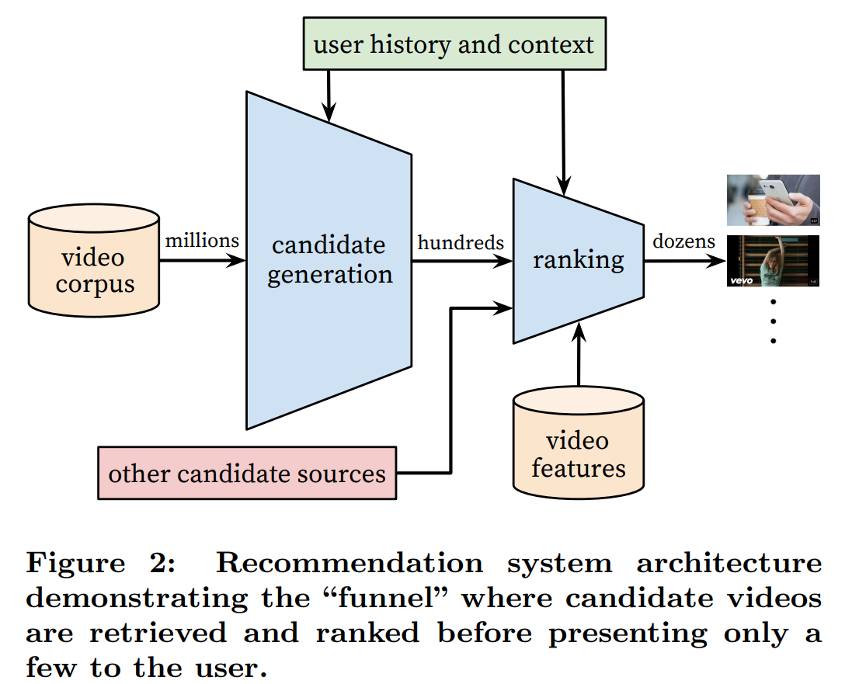
To-Do:
See what happens to the light blue line in the graph 2 slides ago when delta is changed. Experiment with changing the other variables as well, and see what impacts it has on the light blue line (changing the emphasis on delta reduces the emphasis of video extremeness.)
Come up with four total questions that can be answered computationally.
Is it possible to reduce the emphasis on extremeness but keep total minutes watched approximately the same? (see slide 59)
From a Google paper describing the YouTube algorithm: “We consistently observe that users prefer fresh content, though not at the expense of relevance.” Can we add a parameter for the scoring system to account for how new a video is, and see which outputs are affected (minutes watched, number of videos watched, and average extremeness) when newness is weighed heavily (or not)?
Which parameters, when adjusted, reduce the extremeness at the ends? That is, how can we flatten the light blue line to sit at about 0.5 the whole way across?
Do the same observed patterns of extremeness and user behavior (see slide 29) persist with a larger number of agents? What about a larger number of videos?

Slide 43
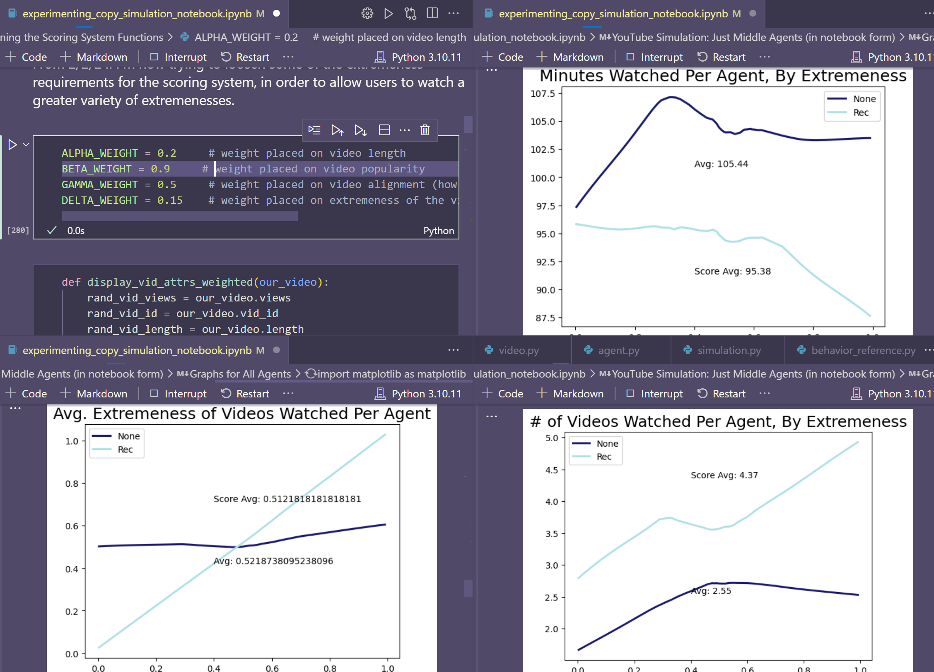
Behind the scenes…splitting the window four ways so I can change the weights and then not have to scroll for the graphs. Took an embarrassingly long time to think of doing.

Slide 44
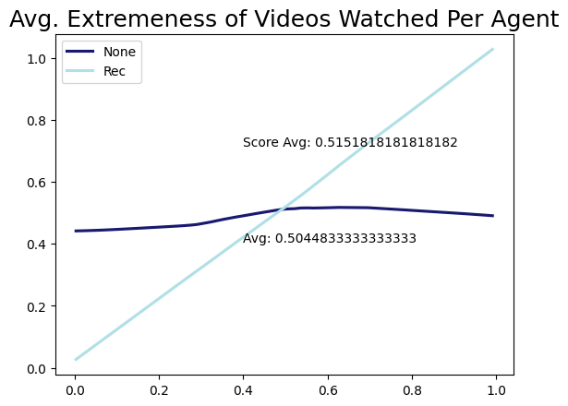
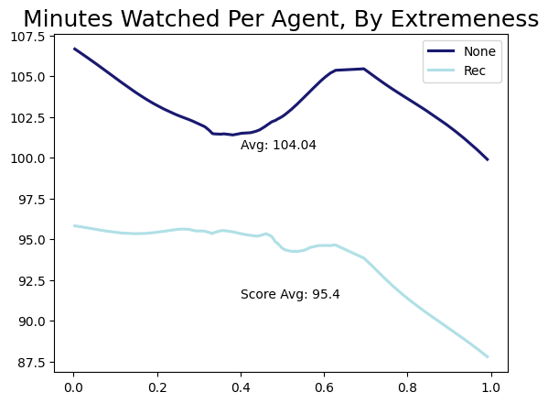
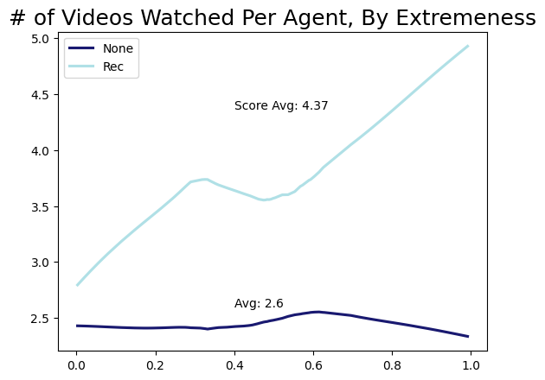
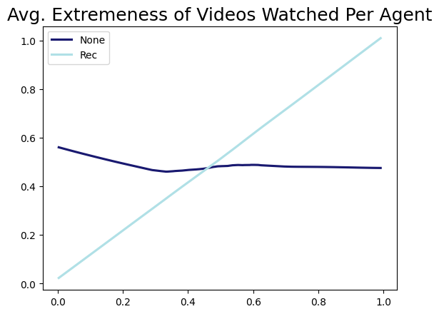


Changing alpha (weight on video length) alpha = 0.0

Slide 45
Todo with this one
Make alpha values more specific (i.e. 0.05, 0.1 or greater than 1: 1.2, 1.3, etc.)

Slide 46



Changing alpha (weight on video length) alpha = 0.4

Slide 47



Changing alpha (weight on video length) alpha = 0.8

Slide 48



Changing beta (weight on video popularity) beta = 0.0

Slide 49



Changing beta (weight on video popularity) beta = 0.3

Slide 50



Changing beta (weight on video popularity) beta = 0.6

Slide 51



Changing beta (weight on video popularity) beta = 0.9

Slide 52



Changing gamma (weight on video alignment) gamma = 0.0

Slide 53



Changing gamma (weight on video alignment) gamma = 0.25

Slide 54



Changing gamma (weight on video alignment) gamma = 0.75

Slide 55



Changing gamma (weight on video alignment) gamma = 1.00

Slide 56



Changing delta (weight on video extremeness) delta = 0.00

Slide 57



Changing delta (weight on video extremeness) delta = 0.30

Slide 58



Changing delta (weight on video extremeness) delta = 0.60

Slide 59
Figure out the delta rewarding videos closer to one thing. Reward videos near the extremes (why do you have it commented out)
Maybe look at the scatter plots for graphs that are really bifurcated
Make testing more efficient (i.e. not having to run each value of gamma manually every single time)

Slide 60



Changing delta (weight on video extremeness) delta = 0.90

Slide 61
Back to our first question…
Can we reduce the extremeness of videos watched, but keep the minutes watched about the same in the scoring system compared to without it?

Slide 62


Attempt 1: ALPHA_WEIGHT = 0.2 # weight placed on video length BETA_WEIGHT = 0.15 # weight placed on video popularity GAMMA_WEIGHT = 0.05 # weight placed on video alignment (how similar extremeness is to user's) DELTA_WEIGHT = 0.05 # weight placed on extremeness of the video

Slide 63


Attempt 2: ALPHA_WEIGHT = 0.5 # weight placed on video length BETA_WEIGHT = 0.15 # weight placed on video popularity GAMMA_WEIGHT = 0.1 # weight placed on video alignment (how similar extremeness is to user's) DELTA_WEIGHT = 0.00 # weight placed on extremeness of the video

Slide 64


Attempt 3: ALPHA_WEIGHT = 0.5 # weight placed on video length BETA_WEIGHT = 0.15 # weight placed on video popularity GAMMA_WEIGHT = 0.00 # weight placed on video alignment (how similar extremeness is to user's) DELTA_WEIGHT = -0.15 # weight placed on extremeness of the video

Slide 65


Attempt 4: ALPHA_WEIGHT = 0.0 # weight placed on video length BETA_WEIGHT = 0.15 # weight placed on video popularity GAMMA_WEIGHT = 0.15 # weight placed on video alignment (how similar extremeness is to user's) DELTA_WEIGHT = -0.15 # weight placed on extremeness of the video

Slide 66


Attempt 5: ALPHA_WEIGHT = 0.0 # weight placed on video length BETA_WEIGHT = 0.15 # weight placed on video popularity GAMMA_WEIGHT = 0.15 # weight placed on video alignment (how similar extremeness is to user's) DELTA_WEIGHT = 0.15 # weight placed on extremeness of the video

Slide 67
This attempt seems to be the closest. I think.
σ = 0.1967, ${\text{σ}}^{2}$ = 0.038725445 (I don’t think standard deviation is best here)

Slide 68
Meeting 2/29/24
I tried doing the random seed (using numpy.random.seed() in each spot that generated a random number, but couldn’t get it to work.
Use the one for random (or whatever one you’re using) (random.seed())
It’s weird because the creation of the agents and videos happens before the simulation part.
For the graphs, next step is trying to get them overlaid onto each other/imposed as one graph so it’s easier to compare the effects of changing alpha/beta/etc.
Also unsure what’s causing the problem in the first graph.
I also have to make sure the graphs all have the same axes numbers---it varies slightly between graphs because it’s not hardcoded to a specific range (even though I know that everything will fall in a specific range).
Might go away

Slide 69






Changing alpha (weight on video length) alpha = 0.05

Slide 70



Changing alpha (weight on video length) alpha = 0.10

Slide 71



Changing alpha (weight on video length) alpha = 0.15

Slide 72



Changing alpha (weight on video length) alpha = 1.05

Slide 73



Changing alpha (weight on video length) alpha = 1.2

Slide 74



Changing alpha (weight on video length) alpha = 1.5

Slide 75



Changing alpha (weight on video length) alpha = 150

Slide 76
A Weird Note
For almost all of them, the scoring average is the exact same: 98.18. Ignoring that this is what’s supposed to be happening for the one WITHOUT the scoring system (the value should be staying the same), I do not know what’s going on here.

Slide 77



Changing gamma just for fun gamma = 50

Slide 78
Meeting 3/18/24

Slide 79
Small sidebar
I need my undergraduate research symposium waiver signed. This lets the UGRS post my research poster/presentation on their website.
Also…I have to make my research poster soon. How do you recommend distilling such a large project into one small poster/talk?

Slide 80




Leaving off from Friday
So, what’s going on with alpha and beta?

Slide 81




alpha (length)
beta (popularity)
delta (vid extremeness)
Could also plot abs value
gamma (alignment)

Slide 82
I can’t tell, but based on the ones around it, it’s a higher number
1.0
0.7
This is what happens when you let matplotlib handle your legends automatically👎

Slide 83

Changing delta (weight on video extremeness)

Slide 84












Changing delta (weight on video extremeness) delta = 0.15
Gamma = 0.5 (normal weight)
delta = 0.15 (normal weight)

Slide 85

Changing gamma (weight on video alignment) gamma = 0.5

Slide 86


Changing gamma (weight on video alignment) gamma = 0.5

Slide 87

Changing gamma (weight on video alignment) gamma = 0.5
Gamma = 0.5 (normal weight)

Slide 88
What does this tell us?
Delta and gamma (video extremeness and video alignment) have the strongest impact on the avg extremeness of videos watched. A higher delta == higher extremeness (in proximity to extreme being 1, I still have to go fix it and I don’t know why I didn’t do that first). Lower delta == closer to average (pay attention to the left axis there). Gamma doesn’t vary the extremeness too much (except for whatever’s going on with 0.1), but it seems that the extremes are pushed towards (higher gamma pushes towards left-leaning videos from center, lower gamma pushes towards right-leaning videos from center).
delta (vid extremeness)
gamma (alignment)

Slide 89

So, what’s up with alpha? And beta, for that matter?
alpha (length)
beta (popularity)
Where are all the other lines????

Slide 90

So, what’s happening?
Alpha is barely changing!
I spent ages changing around the axes and graph colors to see what was happening. Turns out alpha (video length) is just not really having a big effect on video extremeness. Which makes sense. I am assuming the same is the case for beta (video popularity).

Slide 91
Todo for this weekend
Fix delta issue!!!!!!!!! (done!)
Make a lot of graphs (see following slides)
(Almost) all x-axis are the user’s video preference
Alpha x-axis: array of all daily_agent_longest_vid: x_agent_len_thresholds
Beta x-axis: array of all daily_agent_pop_thresh: x_agent_pop_thresholds
Delta x-axis: n/a
Gamma x-axis: same as whatever delta is using now
All y-axis arrays end in _watched
Alpha y-axis: in the array daily_agent_lens, append suggested_video.length (when a video is watched successfully). When that agent is done watching for the day, take the average of daily_agent_lens and append that to y_agent_avg_len_watched
Beta y-axis: in the array daily_agent_pops, append suggested_video.views (when a video is watched successfully). When that agent is done watching for the day, take the average of daily_agent_pops and append that to y_agent_avg_pop_watched
Delta y-axis: n/a
Gamma y-axis: in the array daily_agent_alignments, append the alignment (abs(suggested_video.extremeness – daily_agent_vid_extr)) (when a video is watched successfully). When that agent is done watching for the day, take the average of daily_agent_alignments and append that to y_agent_avg_align_watched

Slide 92
So to recap for the graphs
Alpha x-axis: array of all daily_agent_longest_vid: x_agent_len_thresholds agent_len_thresholds.append(daily_agent_longest_vid)
Alpha y-axis: inside each agent’s run. in the array daily_agent_lens, append suggested_video.length (when a video is watched successfully). When that agent is done watching for the day, take avg(daily_agent_lens) and append that to y_agent_avg_len_watched (outside of each agent)
Alpha x/y pair: (x_agent_len_thresholds, y_agent_avg_len_watched)
Beta x-axis: array of all daily_agent_pop_thresh: x_agent_pop_thresholds
Beta y-axis: in the array daily_agent_pops, append suggested_video.views (when a video is watched successfully). When that agent is done watching for the day, take avg(daily_agent_pops) and append that to y_agent_avg_pop_watched
Beta x/y pair: (x_agent_pop_thresholds, y_agent_avg_pop_watched)
Gamma x-axis: same as whatever delta is using now
Gamma y-axis: in the array daily_agent_alignments, append the alignment (abs(suggested_video.extremeness – daily_agent_vid_extr)) when a video is watched successfully. When that agent is done watching for the day, take the avg(daily_agent_alignments) and append that to y_agent_avg_align_watched
Gamma x/y pair: (whatever delta uses now, y_agent_avg_align_watched)

Slide 93
So to recap for the graphs (2)
Alpha x/y pair: (x_agent_len_thresholds, y_agent_avg_len_watched)
Four graphs: one for all 11 values (0.0 – 1.0) of alpha, beta, gamma, and delta
Beta x/y pair: (x_agent_pop_thresholds, y_agent_avg_pop_watched)
Four graphs: one for all 11 values (0.0 – 1.0) of alpha, beta, gamma, and delta
Gamma x/y pair: (whatever delta uses now, y_agent_avg_align_watched)
Four graphs: one for all 11 values (0.0 – 1.0) of alpha, beta, gamma, and delta

Slide 94



How to make this graph? 3 arrays total
x-axis: agent’s length threshold
y-axis: avg. length watched by that agent today
Need one array inside each agent’s run of the loop to record the length of each video watched, then calculate the avg. of that array for each agent and add it to agent_avg_len_watched

Slide 95
How to make this graph? 3 arrays total
x-axis: agent’s popularity threshold
For each agent, append daily_agent_pop_thresh to agent_pop_thresholds
y-axis: avg. popularity watched by that agent today
Need one array inside each agent’s run of the loop to record the popularity of each video watched, then calculate the avg. of that array for each agent and add it to agent_avg_pop_watched

Slide 96

How to make this graph? 3 arrays total
x-axis: agent’s extremeness, probably, since alignment varies
y-axis: avg. alignment of videos watched by that agent
Need one array inside each agent’s run of the loop to record the alignment of each video watched, then calculate the avg. of that array for each agent and add it to agent_avg_align_watched

Slide 97
How to make this graph? You did already!
x-axis: agent’s extremeness
y-axis: avg. extr of videos watched by that agent
The only thing you need to do is make sure the x-axis is graphing by agent extremeness, not by agent number (even tho they are already sorted by extremeness---just make sure the graph axis titles reflect that)

Slide 98
Sorted by variable
(same variable, different graphs)

Slide 99


Video length (alpha) graphs
Todo: Look again at this one

Slide 100



Video popularity (beta) graphs

Slide 101



Video alignment (gamma) graphs

Slide 102



Video extremeness (delta) graphs
Todo: Look again at this one
make the upper left graph a scatter plot

Slide 103
Sorted by graph
(same graph, with each variable)

Slide 104
New video length (alpha) graphs

Slide 105
New video popularity (beta) graphs

Slide 106

New video extremeness (delta) graphs

Slide 107
New video alignment (gamma) graphs
Getting there…

Slide 108




Seed == ??
TODO: still try having alpha values be between 0.0 and 0.1 to see what’s going on in between there
Seed == 1
Seed == 27
Seed == 25

Slide 109




Look at these individual agents and see why the scores are pushing them differently

Slide 110

Same pattern even with more precise values

Slide 111


I’m confused because there doesn’t seem to be a pattern to it…even when turning off my custom colors to make sure that wasn’t what was messing it up, the only pattern is the same general shape gets made each time across random seeds. The colors don’t land in any particular place. Is it because of how small the differences in the y-axis are?

Slide 112




Seed == 27
Seed == 20. This one looks closer to what I expected

Slide 113




Video extremeness (delta) scatter plots

Slide 114

This one makes sense! Finally!
The purple (higher delta) == higher stratification towards the extremes. This looks like what we drew on the whiteboard last week!
Todo: plot just small medium large since the medium is getting kond of hidden

Slide 116



0.5 is buried under 1.0!
(see next slide)

Slide 117










From 0.3 on, they’re all the same.

Slide 118







Slide 119

The todo here was to run this graph for alpha values from 0.0 – 0.1 to see the smaller changes going on there.
Here, as alpha gets closer to 0.1, the average video length drops off quite a bit. This makes sense, as a higher alpha rewards shorter and shorter videos.

Slide 120

As soon as alpha does not == 0, the big stratified line goes away. I think the line at zero somewhat makes sense (since no alpha==there’s no rules on how short a video has to be anymore), but I guess having even the slightest alpha tones things down a big (but you can still see that the red dots, 0.005, are generally higher up (aka having less of an effect) as you go down the rainbow.

Slide 121

Here are some really, really small alpha values (0.000000000005 to 0.05). I wanted to see how close to zero we could get without the line forming, and it seems really close is the answer. I’m guessing we only see purple because those dots are covering the even smaller dots---aka we’ve hit a point where alpha is so small, it’s no longer making much difference.

Slide 122
alpha: 0.0
Agent's threshold (minutes): 76
Agent's Extremeness: 0.19640310908816028
Shortest video watched: 30
Longest video watched: 63
Agent's threshold (minutes): 47
Agent's Extremeness: 0.2529127327529692
Shortest video watched: 6
Longest video watched: 76
Agent's threshold (minutes): 66
Agent's Extremeness: 0.9096814486371707
Shortest video watched: 6
Longest video watched: 76
Agent's threshold (minutes): 24
Agent's Extremeness: 0.07873212256130502
Shortest video watched: 5
Longest video watched: 76
Agent's threshold (minutes): 69
Agent's Extremeness: 0.05271211756414318
Shortest video watched: 5
Longest video watched: 76
Agent's threshold (minutes): 59
Agent's Extremeness: 0.4785107765565735
Shortest video watched: 5
Longest video watched: 76
Agent's threshold (minutes): 58
Agent's Extremeness: 0.8145167270618204
Shortest video watched: 5
Longest video watched: 76
alpha: 1.0
Agent's threshold (minutes): 76
Agent's Extremeness: 0.19640310908816028
Shortest video watched: 2
Longest video watched: 55
Agent's threshold (minutes): 47
Agent's Extremeness: 0.2529127327529692
Shortest video watched: 2
Longest video watched: 55
Agent's threshold (minutes): 66
Agent's Extremeness: 0.9096814486371707
Shortest video watched: 2
Longest video watched: 63
Agent's threshold (minutes): 24
Agent's Extremeness: 0.07873212256130502
Shortest video watched: 2
Longest video watched: 63
Agent's threshold (minutes): 69
Agent's Extremeness: 0.05271211756414318
Shortest video watched: 2
Longest video watched: 63
Agent's threshold (minutes): 59
Agent's Extremeness: 0.4785107765565735
Shortest video watched: 2
Longest video watched: 63
Agent's threshold (minutes): 58
Agent's Extremeness: 0.8145167270618204
Shortest video watched: 2
Longest video watched: 63
Length thresholds range from 15 to 90. However, video lengths range from 1 to 80.

Slide 123


Slide 124


Slide 125


Slide 126


Slide 127


Slide 128


Slide 129


Slide 130


Slide 131


Slide 132


Slide 133


Slide 134

I wanted to see how the scores trend as alpha gets bigger and bigger (remember, smaller score == good). This shows that as alpha increases, the average score for a video increases in magnitude (gets smaller, since this is all negative). Thus, as alpha increases, a video’s score gets even lower, with most videos being clustered at shorter lengths. More weight is being pushed in the negative direction, so alpha is having a much larger impact than other factors.
(x,y) pair: (lookup_dict[agent_scores[j][0]].length, agent_scores[j][1])
(video length, video score)
For all videos watched by every agent today
Todo: figure out why the score isn’t lower for longer videos

Slide 135

So, does that answer the random dots?
I think so. As the previous five million slides show, videos with longer lengths are still allowed through the scoring system, even with a higher emphasis on videos being short. Thus, it makes sense that agents would be watching those videos, albeit not very much.

